Slide 1
Book Tracking System
A Smart Solution for Managing Reading Activity

Slide 2

Introduction
Many readers struggle to consistently track their reading progress due to busy schedules or simply forgetting to log their sessions. Over time, this leads to unfinished books, loss of motivation, and lack of insight into their own reading habits. Readers often wish they had a personal assistant that could remind them to read, track their time spent, and help them stay on target to finish books by their planned deadlines. They also desire useful statistics and monthly summaries of their reading patterns to reflect on their progress and improve their habits.

Slide 3
System Overview
01

Slide 4
Cloud-Based Infrastructure
The system is designed to be hosted on AWS, utilizing its robust cloud infrastructure to ensure high availability and minimal downtime. By leveraging AWS services like RDS connected with MySQL Workbench for a scalable database, the application can efficiently manage user data and log details about each book. This setup enables seamless access for users and ensures that the system can handle growth in user numbers and reading data.

Slide 5
User Input Mechanism
Users will log their reading activities through an intuitive web interface, where they can input essential book details including the title, author, start and expected end date, and total page count. The system will allow easy updates to reading status and time spent on each book. A user-friendly design ensures that even those with busy schedules can quickly log their reading, thus maintaining an accurate record of their progress.

Slide 6

Data Management Features
The system incorporates comprehensive data management features that facilitate the efficient logging and tracking of reading activities. Users can store detailed information about each book, including title, author, start and expected completion dates, and page counts. This enables precise tracking of reading pace and allows users to see their progress at a glance. Additionally, the data retrieval process is optimized for quick access, ensuring users receive timely updates on their reading journey.

Slide 7
Functionality
02

Slide 8
Real-Time Updates
Real-time updates are crucial for maintaining accurate reading logs. By using AWS Lambda for serverless computing, the system can automatically update the reading time as users log their reading sessions. This feature ensures that every minute spent reading is accounted for instantly, which helps users understand their reading habits and maintain momentum towards completing their books.

Slide 9

Automated Reminders
To promote consistent reading habits, the system includes an automated reminder feature using Amazon SNS. If no reading activity is logged for a predetermined period, users will receive timely email reminders to encourage them to resume their reading activities. This function helps to prevent users from losing sight of their reading goals and instills a sense of accountability.

Slide 10
Monthly Reporting
The system generates comprehensive monthly reports summarizing users' reading patterns and progress. These reports provide insights into the number of books read, average reading time, and trends over the month. By analyzing this data, users can identify areas for improvement in their reading habits and set more achievable goals for the upcoming month.

Slide 11
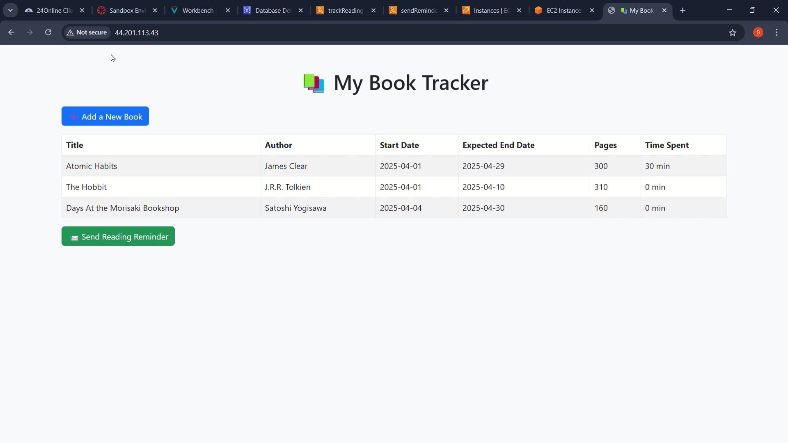

Slide 12
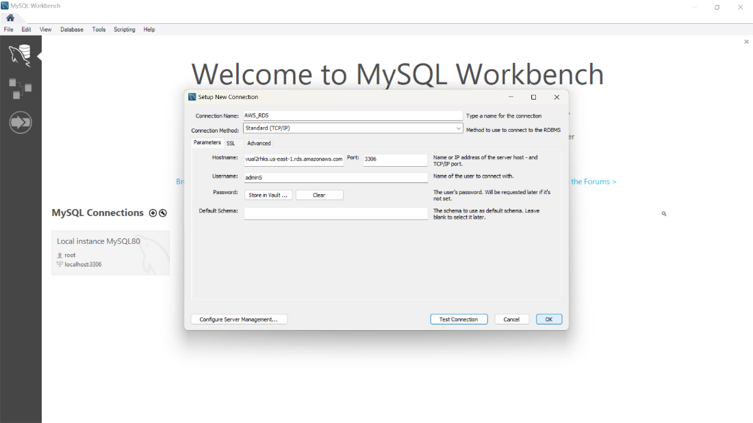
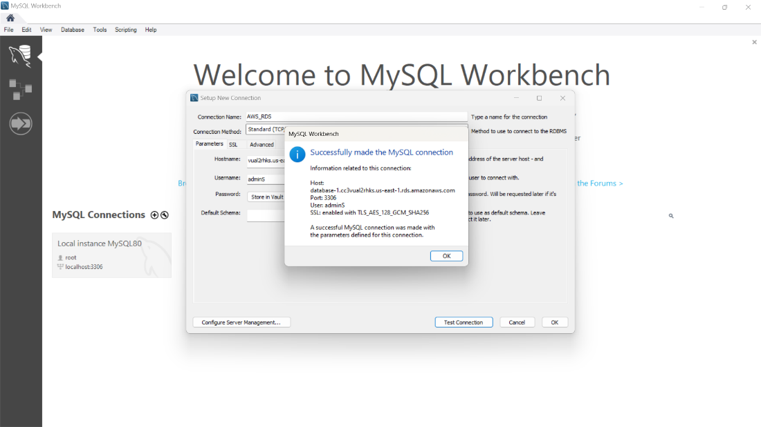
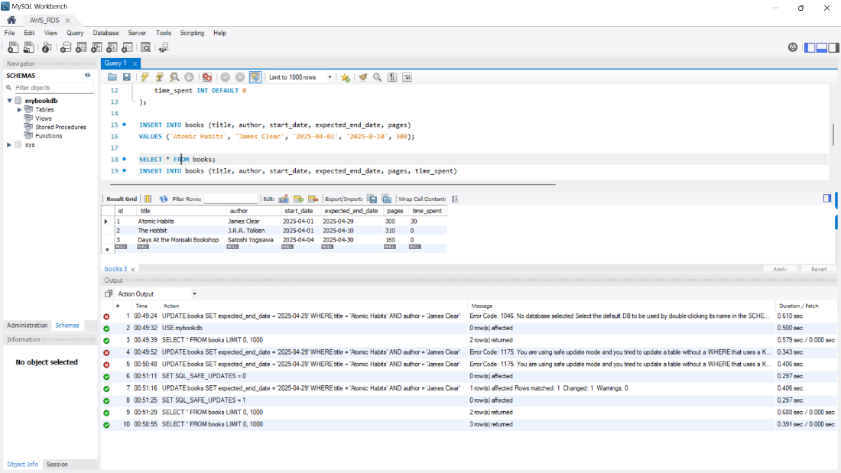
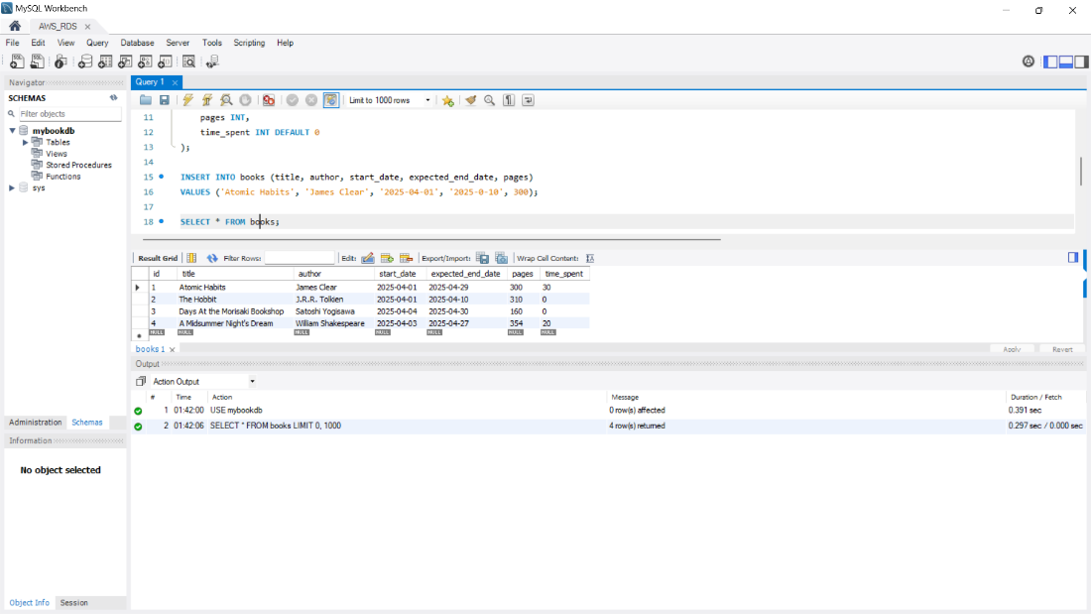

Slide 13

Conclusions
The proposed cloud-based book tracking system offers a robust solution for readers looking to enhance their reading experience. By integrating features such as real-time updates, automated reminders, and monthly reporting, the system addresses the common challenges faced by readers. This comprehensive approach not only helps users stay organized but also fosters discipline and consistency in their reading habits.

Slide 14
Thank you!
Do you have any questions?
Do you have any questions?

